Slide 1
Software cost estimation

Slide 2
Objectives
To introduce the fundamentals of software costing and pricing
To describe three metrics for software productivity assessment
To explain why different techniques should be used for software estimation
To describe the principles of the COCOMO 2 algorithmic cost estimation model

Slide 3
Topics covered
Software productivity
Estimation techniques
Algorithmic cost modelling
Project duration and staffing

Slide 4
Fundamental estimation questions
How much effort is required to complete an activity?
How much calendar time is needed to complete an activity?
What is the total cost of an activity?
Project estimation and scheduling are interleaved management activities.

Slide 5
Software cost components
Hardware and software costs.
Travel and training costs.
Effort costs (the dominant factor in most
projects)
  The salaries of engineers involved in the project;
  Social and insurance costs.
Effort costs must take overheads into account
  Costs of building, heating, lighting.
  Costs of networking and communications.
  Costs of shared facilities (e.g library, staff restaurant, etc.).

Slide 6
Costing and pricing
Estimates are made to discover the cost, to the developer, of producing a software system.
There is not a simple relationship between the development cost and the price charged to the customer.
Broader organisational, economic, political and business considerations influence the price charged.

Slide 7
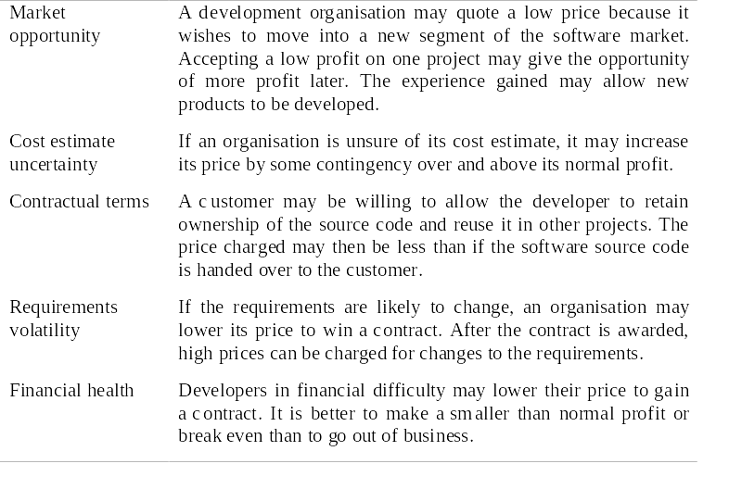
Software pricing factors

Slide 8
Software productivity
A measure of the rate at which individual
engineers involved in software development
produce software and associated
documentation.
Not quality-oriented although quality assurance is a factor in productivity assessment.
Essentially, we want to measure useful
functionality produced per time unit.

Slide 9
Productivity measures
Size related measures based on some output from the software process. This may be lines of delivered source code, object code instructions, etc.
Function-related measures based on an estimate of the functionality of the delivered software. Function-points are the best known of this type of measure.

Slide 10
Measurement problems
Estimating the size of the measure (e.g. how many function points).
Estimating the total number of programmer
months that have elapsed.
Estimating contractor productivity (e.g.
documentation team) and incorporating this
estimate in overall estimate.

Slide 11
Lines of code
What's a line of code?
  The measure was first proposed when programs were typed on cards with one line per card;
  How does this correspond to statements as in Java which can span several lines or where there can be several statements on one line.
What programs should be counted as part of the system?
This model assumes that there is a linear relationship between system size and volume of documentation.

Slide 12
Productivity comparisons
The lower level the language, the more
productive the programmer
  The same functionality takes more code to implement in a lower-level language than in a high-level language.
The more verbose the programmer, the higher
the productivity
  Measures of productivity based on lines of code suggest that programmers who write verbose code are more productive than programmers who write compact code.

Slide 13
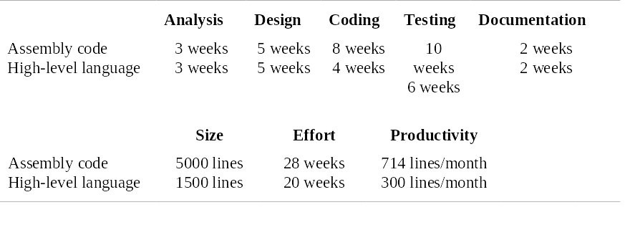
System development times

Slide 14
Function points
Based on a combination of program characteristics
  external inputs and outputs;
  user interactions;
  external interfaces;
  files used by the system.
A weight is associated with each of these and the function point count is computed by multiplying each raw count by the weight and summing all values.

Slide 15
Function points
The function point count is modified by complexity of the project
FPs can be used to estimate LOC depending on the average number of LOC per FP for a given language
  LOC = AVC * number of function points;
FPs are very subjective. They depend on the estimator
  Automatic function-point counting is impossible.

Slide 16
Productivity estimates
Real-time embedded systems, 40-160
LOC/P-month.
Systems programs , 150-400 LOC/P-month.
Commercial applications, 200-900
LOC/P-month.
In object points, productivity has been measured between 4 and 50 object points/month depending on tool support and developer capability.

Slide 17
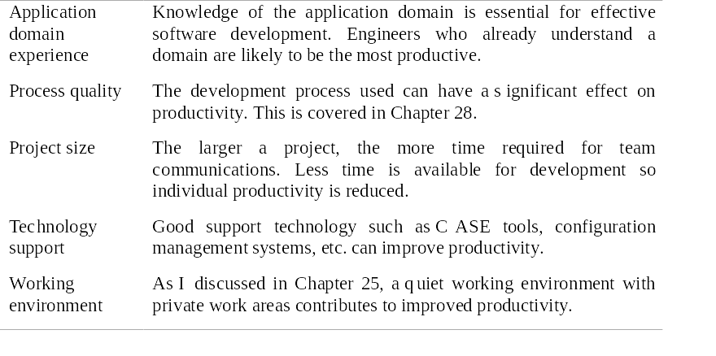
Factors affecting productivity

Slide 18
Quality and productivity
All metrics based on volume/unit time are
flawed because they do not take quality into
account.
Productivity may generally be increased at the
cost of quality.
It is not clear how productivity/quality metrics
are related.
If requirements are constantly changing then an approach based on counting lines of code is not meaningful as the program itself is not static;

Slide 19
Estimation techniques
There is no simple way to make an accurate estimate of the effort required to develop a software system
  Initial estimates are based on inadequate information in a user requirements definition;
  The software may run on unfamiliar computers or use new technology;
  The people in the project may be unknown.
Project cost estimates may be self-fulfilling
  The estimate defines the budget and the product is adjusted to meet the budget.

Slide 20
Changing technologies
Changing technologies may mean that previous estimating experience does not carry over to new systems
  Distributed object systems rather than mainframe systems;
  Use of web services;
  Use of ERP or database-centred systems;
  Use of off-the-shelf software;
  Development for and with reuse;
  Development using scripting languages;
  The use of CASE tools and program generators.

Slide 21
Estimation techniques
Algorithmic cost modelling.
Expert judgement.
Estimation by analogy.
Parkinson's Law.
Pricing to win.

Slide 22
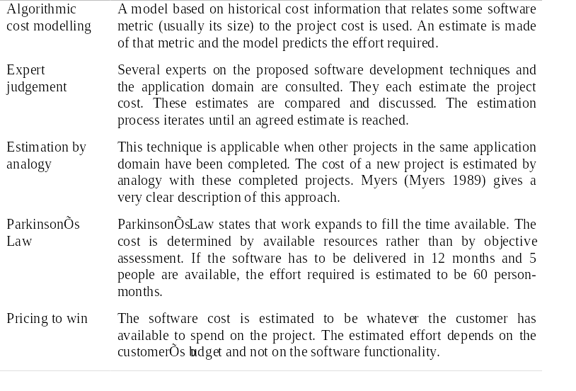
Estimation techniques

Slide 23
Pricing to win
The project costs whatever the customer has to spend on it.
Advantages:
  You get the contract.
Disadvantages:
  The probability that the customer gets the system he or she wants is small. Costs do not accurately reflect the work required.

Slide 24
Top-down and bottom-up estimation
Any of these approaches may be used top-down or bottom-up.
Top-down
  Start at the system level and assess the overall system functionality and how this is delivered through sub-systems.
Bottom-up
  Start at the component level and estimate the effort required for each component. Add these efforts to reach a final estimate.

Slide 25
Top-down estimation
Usable without knowledge of the system architecture and the components that might be part of the system.
Takes into account costs such as integration, configuration management and documentation.
Can underestimate the cost of solving difficult low-level technical problems.

Slide 26
Bottom-up estimation
Usable when the architecture of the system is known and components identified.
This can be an accurate method if the system has been designed in detail.
It may underestimate the costs of system level activities such as integration and documentation.

Slide 27
Estimation methods
Each method has strengths and weaknesses.
Estimation should be based on several methods.
If these do not return approximately the same result, then you have insufficient information available to make an estimate.
Some action should be taken to find out more in order to make more accurate estimates.
Pricing to win is sometimes the only applicable method.

Slide 28
Pricing to win
This approach may seem unethical and un-businesslike.
However, when detailed information is lacking it may be the only appropriate strategy.
The project cost is agreed on the basis of an outline proposal and the development is constrained by that cost.
A detailed specification may be negotiated or an evolutionary approach used for system development.

Slide 29
Algorithmic cost modelling
Cost is estimated as a mathematical function of
product, project and process attributes whose
values are estimated by project managers:
  Effort = A × Size^{B} × M
  A is an organisation-dependent constant, B reflects the disproportionate effort for large projects and M is a multiplier reflecting product, process and people attributes.
The most commonly used product attribute for cost
estimation is code size.
Most models are similar but they use different values for A, B and M.

Slide 30
Estimation accuracy
The size of a software system can only be known accurately when it is finished.
Several factors influence the final size
  Use of COTS and components;
  Programming language;
  Distribution of system.
As the development process progresses then the size estimate becomes more accurate.

Slide 31
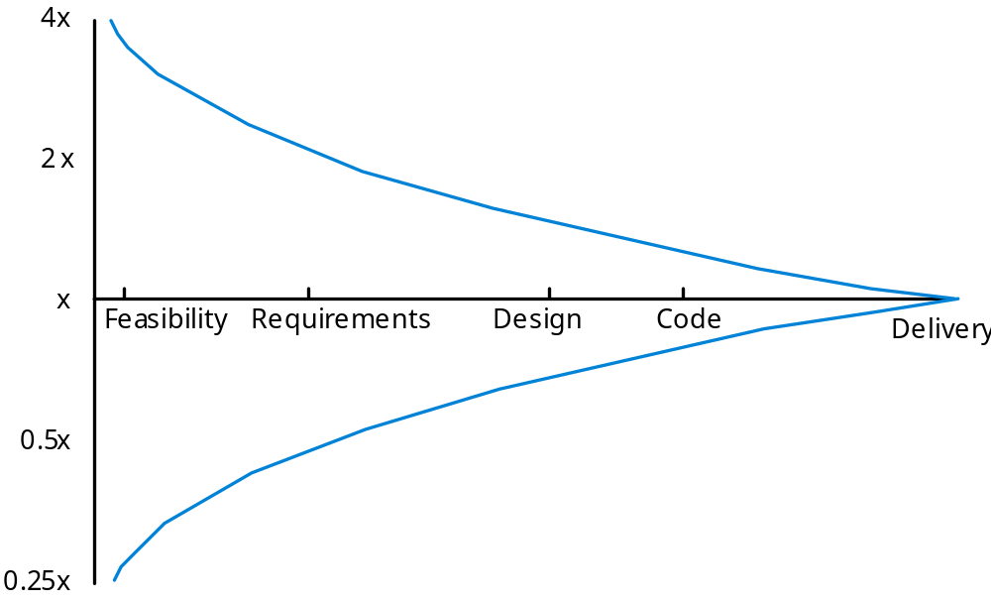
Estimate uncertainty

Slide 32
The COCOMO model
An empirical model based on project experience.
Well-documented, ‘independent’ model which is not tied to a specific software vendor.
Long history from initial version published in 1981 (COCOMO-81) through various instantiations to COCOMO 2.
COCOMO 2 takes into account different approaches to software development, reuse, etc.

Slide 33
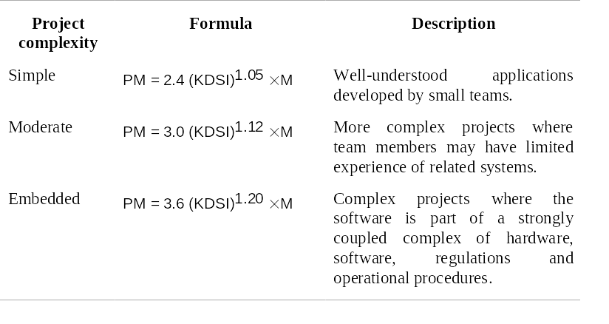
COCOMO 81

Slide 34
COCOMO 2
COCOMO 81 was developed with the assumption that a waterfall process would be used and that all software would be developed from scratch.
Since its formulation, there have been many changes in software engineering practice and COCOMO 2 is designed to accommodate different approaches to software development.

Slide 35
COCOMO 2 models
COCOMO 2 incorporates a range of sub-models that produce increasingly detailed software estimates.
The sub-models in COCOMO 2 are:
  Application composition model. Used when software is composed from existing parts.
  Early design model. Used when requirements are available but design has not yet started.
  Reuse model. Used to compute the effort of integrating reusable components.
  Post-architecture model. Used once the system architecture has been designed and more information about the system is available.

Slide 36
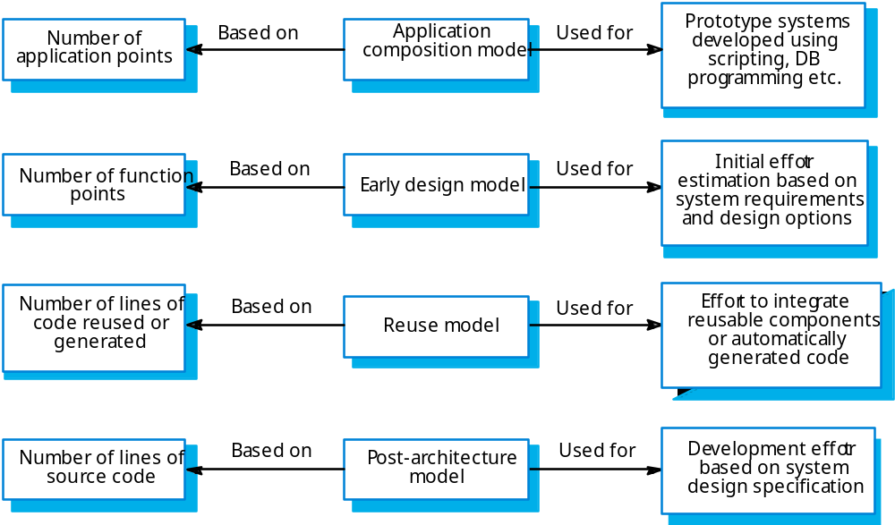
Use of COCOMO 2 models

Slide 37
Application composition model
Supports prototyping projects and projects where there is extensive reuse.
Based on standard estimates of developer productivity in application (object) points/month.
Takes CASE tool use into account.
Formula is
  PM = ( NAP × (1 - %reuse/100 ) ) / PROD
  PM is the effort in person-months, NAP is the number of application points and PROD is the productivity.

Slide 38
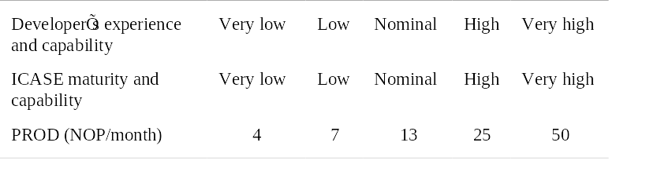
Object point productivity

Slide 39
Early design model
Estimates can be made after the requirements have been agreed.
Based on a standard formula for algorithmic models
  PM = A × Size^{B} × M where
  M = PERS × RCPX × RUSE × PDIF × PREX × FCIL × SCED;
  A = 2.94 in initial calibration, Size in KLOC, B varies from 1.1 to 1.24 depending on novelty of the project, development flexibility, risk management approaches and the process maturity.

Slide 40
Multipliers
Multipliers reflect the capability of the developers, the non-functional requirements, the familiarity with the development platform, etc.
  RCPX - product reliability and complexity;
  RUSE - the reuse required;
  PDIF - platform difficulty;
  PREX - personnel experience;
  PERS - personnel capability;
  SCED - required schedule;
  FCIL - the team support facilities.

Slide 41
The reuse model
Takes into account black-box code that is reused without change and code that has to be adapted to integrate it with new code.
There are two versions:
  Black-box reuse where code is not modified. An effort estimate (PM) is computed.
  White-box reuse where code is modified. A size estimate equivalent to the number of lines of new source code is computed. This then adjusts the size estimate for new code.

Slide 42
Reuse model estimates 1
For generated code:
  PM = (ASLOC * AT/100)/ATPROD
  ASLOC is the number of lines of generated code
  AT is the percentage of code automatically generated.
  ATPROD is the productivity of engineers in integrating this code.

Slide 43
Reuse model estimates 2
When code has to be understood and integrated:
  ESLOC = ASLOC * (1-AT/100) * AAM.
  ASLOC and AT as before.
  AAM is the adaptation adjustment multiplier computed from the costs of changing the reused code, the costs of understanding how to integrate the code and the costs of reuse decision making.

Slide 44
Post-architecture level
Uses the same formula as the early design model but with 17 rather than 7 associated multipliers.
The code size is estimated as:
  Number of lines of new code to be developed;
  Estimate of equivalent number of lines of new code computed using the reuse model;
  An estimate of the number of lines of code that have to be modified according to requirements changes.

Slide 45
The exponent term
This depends on 5 scale factors (see next slide). Their sum/100 is added to 1.01
A company takes on a project in a new domain. The client has not defined the process to be used and has not allowed time for risk analysis. The company has a CMM level 2 rating.
  Precedenteness - new project (4)
  Development flexibility - no client involvement - Very high (1)
  Architecture/risk resolution - No risk analysis - V. Low .(5)
  Team cohesion - new team - nominal (3)
  Process maturity - some control - nominal (3)
Scale factor is therefore 1.17.

Slide 46
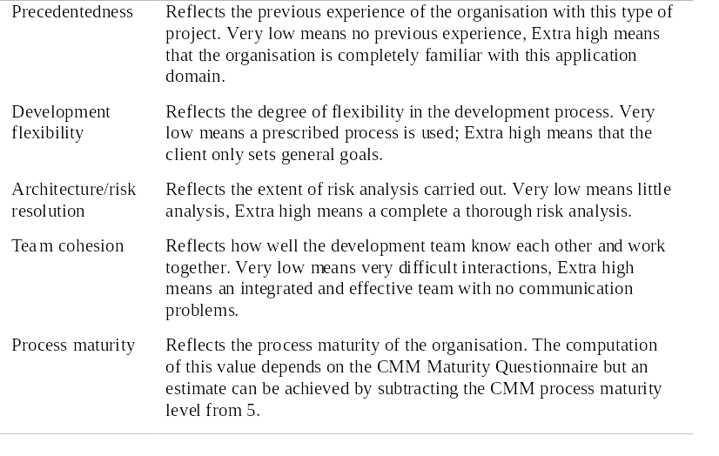
Exponent scale factors

Slide 47
Multipliers
Product attributes
  Concerned with required characteristics of the software product being developed.
Computer attributes
  Constraints imposed on the software by the hardware platform.
Personnel attributes
  Multipliers that take the experience and capabilities of the people working on the project into account.
Project attributes
  Concerned with the particular characteristics of the software development project.

Slide 48
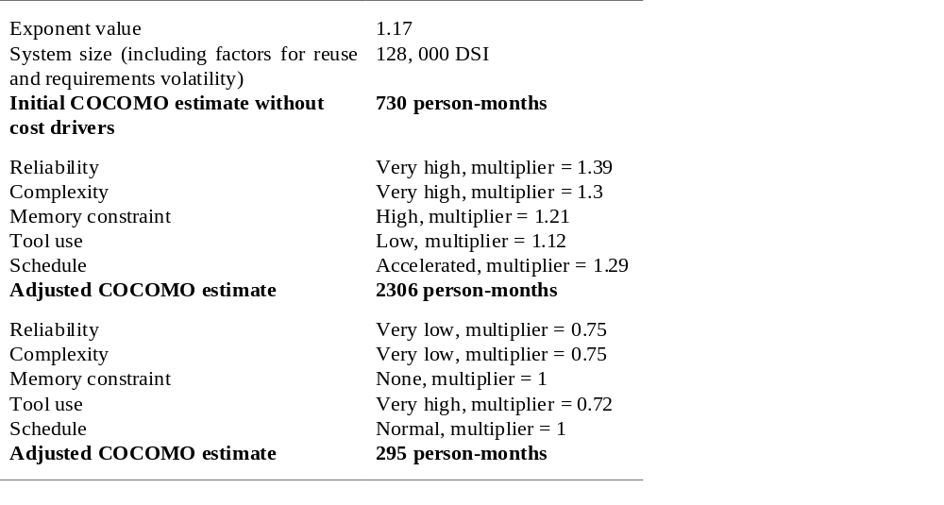
Effects of cost drivers

Slide 49
Project planning
Algorithmic cost models provide a basis for
project planning as they allow alternative
strategies to be compared.
Embedded spacecraft system
  Must be reliable;
  Must minimise weight (number of chips);
  Multipliers on reliability and computer constraints > 1.
Cost components
  Target hardware;
  Development platform;
  Development effort.

Slide 50
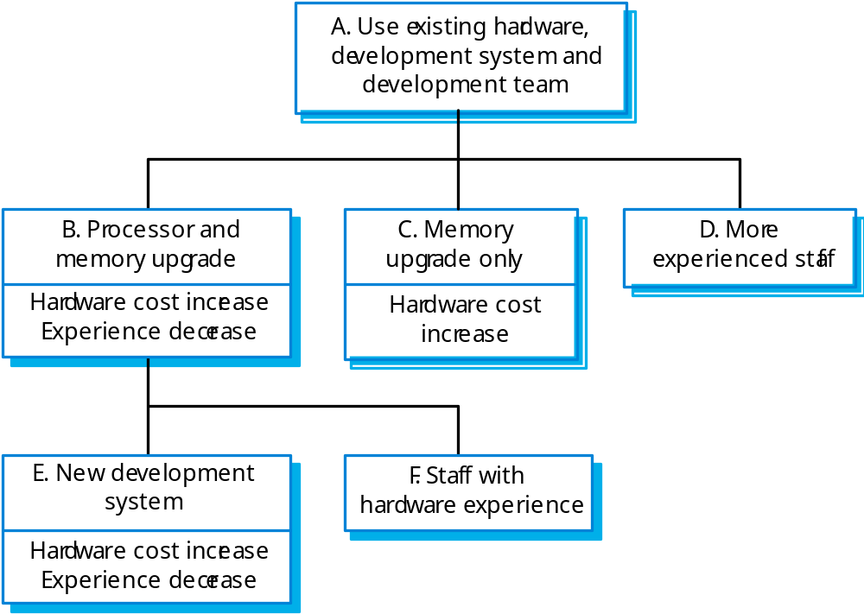
Management options

Slide 51
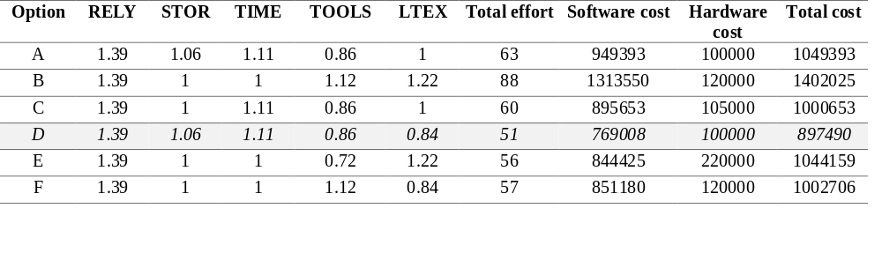
Management option costs

Slide 52
Option choice
Option D (use more experienced staff) appears to be the best alternative
  However, it has a high associated risk as experienced staff may be difficult to find.
Option C (upgrade memory) has a lower cost saving but very low risk.
Overall, the model reveals the importance of staff experience in software development.

Slide 53
Project duration and staffing
As well as effort estimation, managers must estimate the calendar time required to complete a project and when staff will be required.
Calendar time can be estimated using a COCOMO 2 formula
  TDEV = 3 × (PM)^{(0.33+0.2*(B-1.01))}
  PM is the effort computation and B is the exponent computed as discussed above (B is 1 for the early prototyping model). This computation predicts the nominal schedule for the project.
The time required is independent of the number of people working on the project.

Slide 54
Staffing requirements
Staff required can’t be computed by diving the development time by the required schedule.
The number of people working on a project varies depending on the phase of the project.
The more people who work on the project, the more total effort is usually required.
A very rapid build-up of people often correlates with schedule slippage.

Slide 55
Key points
There is not a simple relationship between the price charged for a system and its development costs.
Factors affecting productivity include individual aptitude, domain experience, the development project, the project size, tool support and the working environment.
Software may be priced to gain a contract and the functionality adjusted to the price.

Slide 56
Key points
Different techniques of cost estimation should be used when estimating costs.
The COCOMO model takes project, product, personnel and hardware attributes into account when predicting effort required.
Algorithmic cost models support quantitative option analysis as they allow the costs of different options to be compared.
The time to complete a project is not proportional to the number of people working on the project.

